Slide 1






Bootcamp
Roles and Tasks in an IT Company
Basic Level
CAROLINA GOMEZ M.
May 24th, 2024

Slide 2
Table of content
1
Review
2
Roles & Tasks in IT
3
Practice

Slide 3
What did we study last class?
Review flashcards:prefixes & suffixes
New Vocabulary
Prefixes & Suffixes
https://wordwall.net/es/resource/70871546

Slide 4

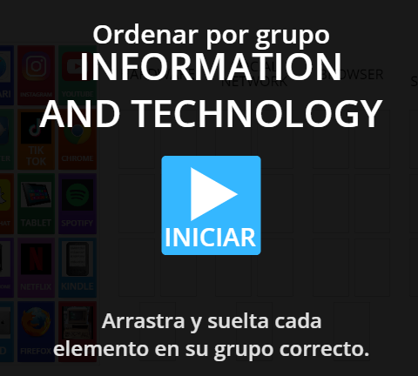
Warm up:
Drag & Drop
https://wordwall.net/es/resource/70871807

Slide 5

READING TIME!
The use of information technology (IT) and internet devices has become something of a necessity for modern businesses of all sizes. As a result, many of these organizations now opt to create a department of IT professionals responsible for managing the company’s IT services and devices. An IT department is the division within an organization that supervises technology-related tasks and responsibilities.
Information technology (IT) personnel are vital to a business, as they provide support when computer systems or networks malfunction. Their roles in the department differ depending on how they help solve emerging technological challenges in the office to minimise disruptions. Understanding the different roles and responsibilities within the IT department can help you decide which path is right for you.
Roles & Tasks in IT
(Part 1)

Slide 6
Roles & Tasks in IT
IT Manager
The IT Manager’s responsibilities include general day-to-day operations of the IT department, managing the IT team, and ensuring that all IT projects are completed on time and within budget. They are also the main point of contact when ensuring all IT infrastructure is running smoothly and securely.
Network Administrator
The Network Administrator is the role in the IT department responsible for managing the organization’s computer network. They install, configure, and maintain network hardware and software, monitor network performance, and troubleshoot network issues as they arise.
IT Department Structure and Roles
The structure of an IT department varies depending on a business’s size and needs. Every person in the IT department has an essential task to perform in an organisation. A company may employ various people responsible for different areas in the department.
Chief Technology Officer (CTO)
The CTO is the head of the IT department, responsible for developing and implementing the company’s IT strategy. They work closely with other senior executives to ensure the IT department and business tech stack are in alignment with the organization’s goals, and they oversee the overall IT budget and resources.

Slide 7
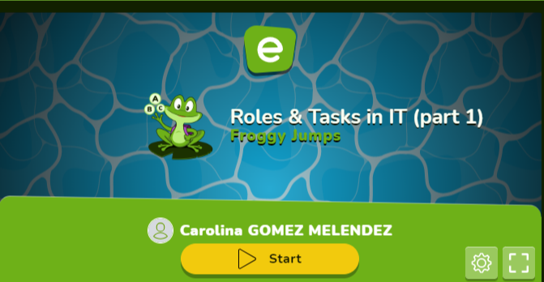
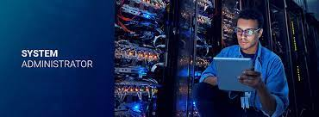
Roles & Tasks in IT
System Administrator
Similarly, the System Administrator is responsible for managing the business’s computer systems, including servers, databases, and operating systems. They ensure that these systems are running smoothly and securely and troubleshoot any problems as needed.
https://es.educaplay.com/recursos-educativos/18808052-roles_tasks_in_it_part_1.html

Slide 8

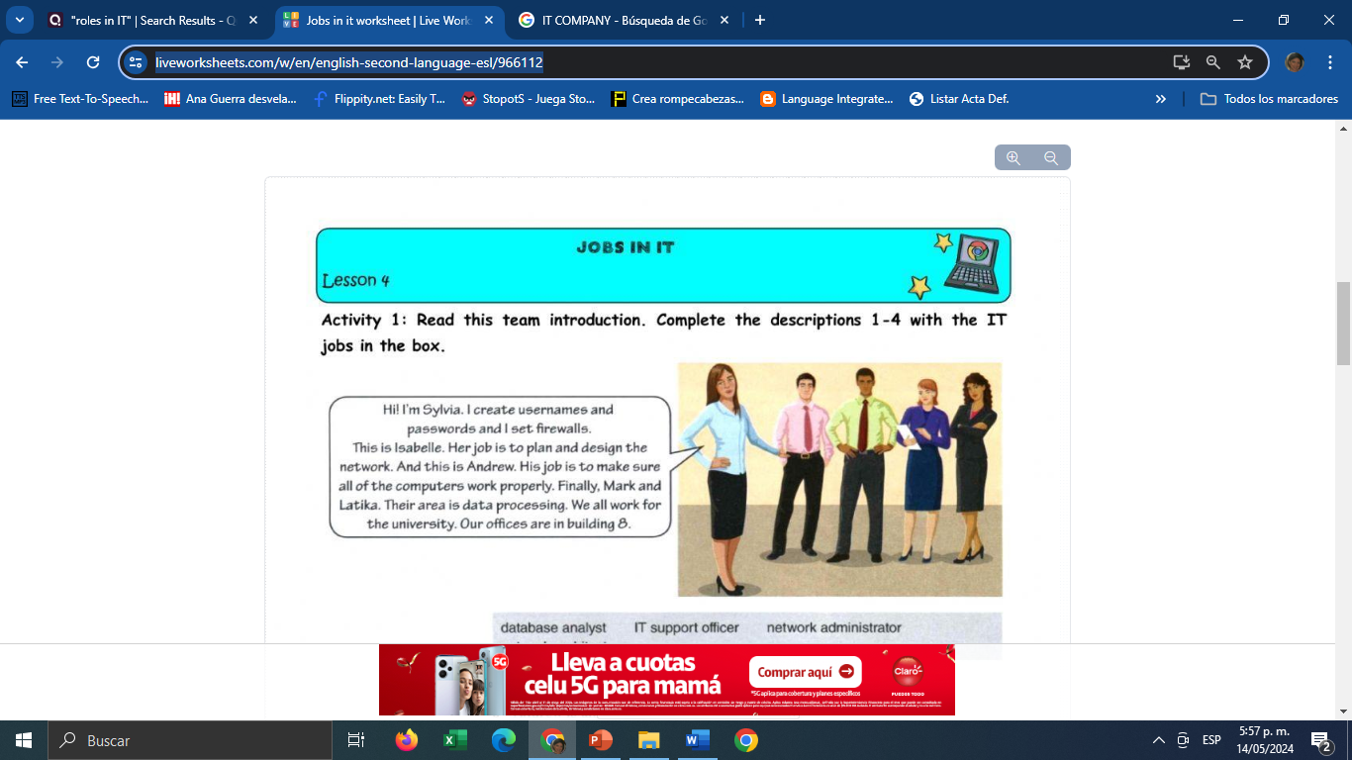
PRACTICE # 1
https://www.liveworksheets.com/w/en/english-second-language-esl/966112
Notes:
Video: https://www.youtube.com/watch?v=7trO3sQzmf8&t=1s

Slide 9

PRACTICE # 2
https://wordwall.net/resource/73294136/roles-and-tasks-in-an-it-companypart-1
Notes:
Video: https://www.youtube.com/watch?v=7trO3sQzmf8&t=1s

Slide 10

Roles & Tasks in IT (Part 2)
Security Administrator
The Security Administrator’s role in the IT department is to maintain the security of the organization’s IT infrastructure. They implement security measures to protect against cyber attacks, monitor the network for security threats, and respond to security incidents.
Application Developer
An Application Developer designs software applications to meet an organization’s specific requirements, usually if an out-of-the-box alternative is not available. They are responsible for writing code, testing applications, and ensuring apps are running smoothly.
Help Desk Support
The Help Desk Support team provides technical support to employees who are experiencing IT issues. They troubleshoot and resolve IT problems, either remotely or on-site at an office.

Slide 11

Roles & Tasks in IT
Database Administrator
The Database Administrator manages the organization’s databases, ensuring they are secure, reliable, and efficient. They also ensure data is backed up and can be restored in the event of a breach.
Web Developer
The Web Developer designs and develops websites and web applications. They are responsible for writing code, testing applications, and ensuring the smooth running of a company’s website.
.
In addition to these roles, larger IT department structures may include specialized teams for areas such as data analytics, cloud computing, and project management

Slide 12

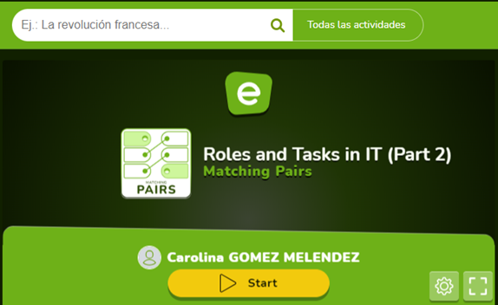
Roles & Tasks in IT
Match the Roles to their corresponding Tasks.
https://es.educaplay.com/recursos-educativos/18464647-roles_and_tasks_in_it_part_2.html
Notes:
Graph: https://www.devopsschool.com/blog/wp-content/uploads/2020/11/Job-Roles-Job-Titles-in-Software-and-IT-Companies1.png

Slide 13
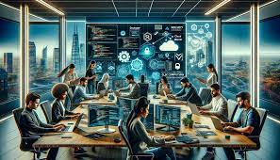
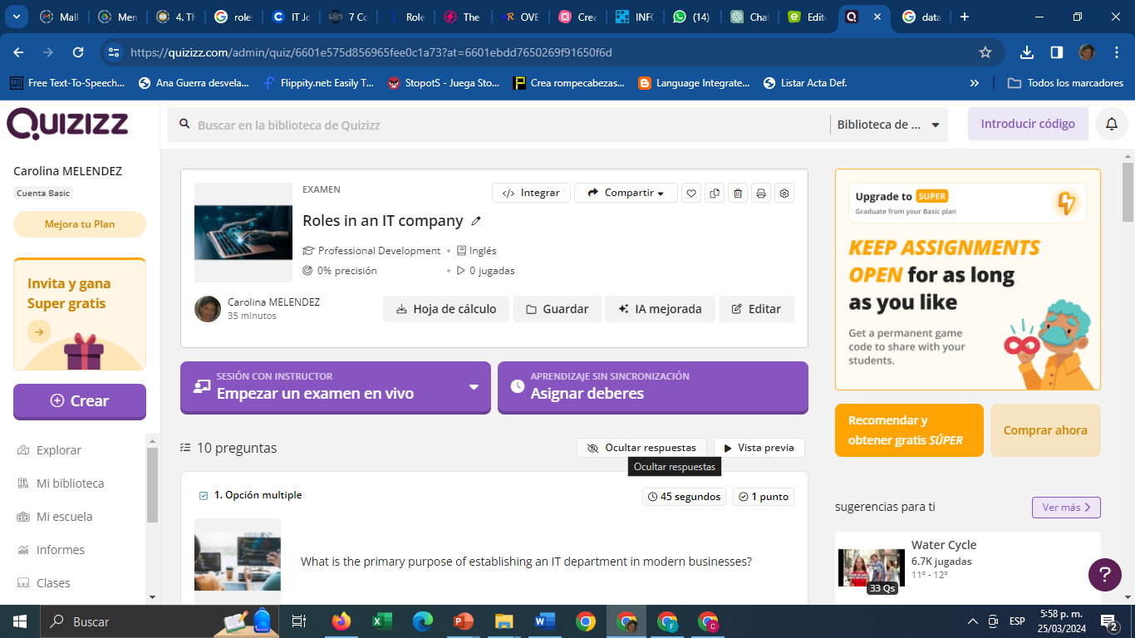
Reading Comprehension Activity
https://quizizz.com/admin/quiz/6601e575d856965fee0c1a73?at=6601ebdd7650269f91650f6d
Notes:
Video: https://www.youtube.com/watch?v=7trO3sQzmf8&t=1s

Slide 14

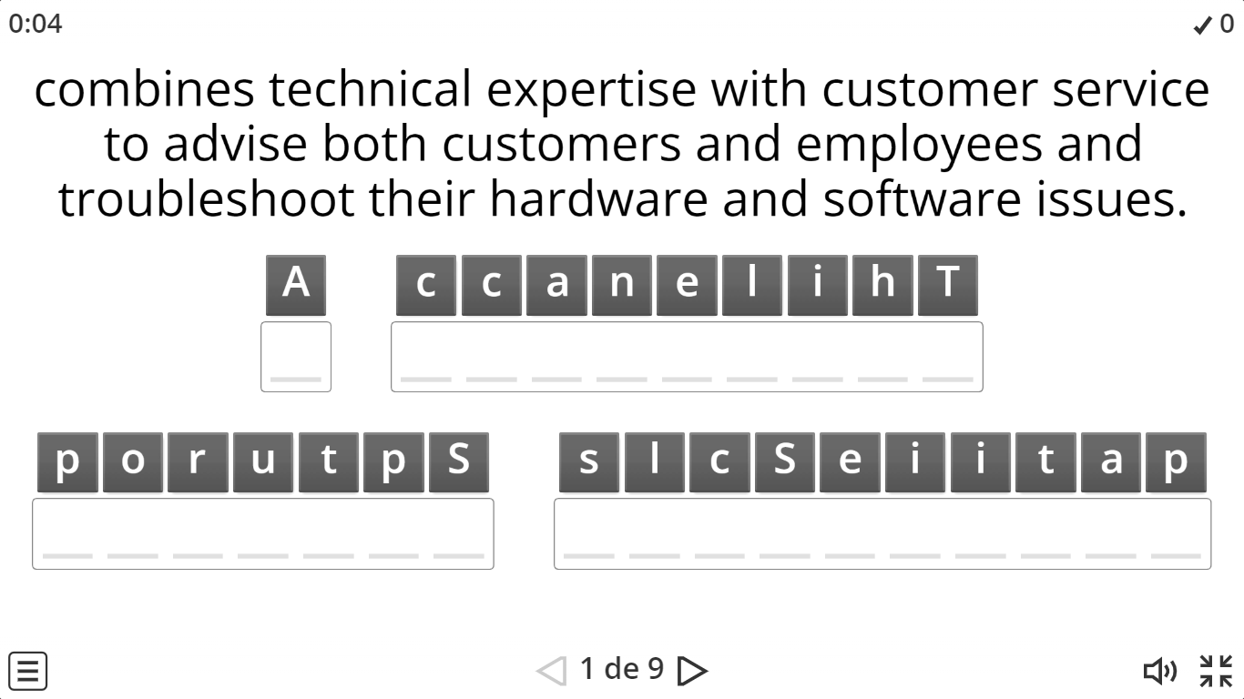
Anagrams
Read the definition and unscramble the letters to get the job.
https://wordwall.net/es/resource/70654305/jobs-in-it

Slide 15


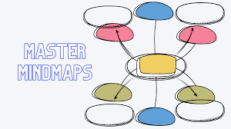
Homework # 4
Get into groups of 4 people and create a Mindmap to show your understanding of the Reading.
To create the mindmap you can use these links or any other of your preferences.
https://slidesgo.com/es/busqueda?q=mapas+mentales#rs=search
https://slidesgo.com/es/busqueda?q=mapas+conseptuales#rs=search
Then upload it to the drive of the Students’ activities.
Notes:
Answers to the comprehension questions:
1. Bob's main concern regarding robots and automation is that they will take over jobs, leading to unemployment and potentially causing societal upheaval.
2. The speaker counters Bob's concerns by pointing out that technological advancements have historically led to increased efficiency and prosperity, and that humans have adapted to these changes by learning new skills.
3. The speaker uses the example of the Industrial Revolution to illustrate the impact of technological advancements on employment, highlighting how automation has led to fewer people working fewer hours to achieve greater prosperity.
4. Some benefits of automation mentioned in the text include increased efficiency, reduced workload, and the ability to perform tasks that are difficult, dirty, dangerous, or time-consuming.
5. The speaker suggests that humans adapt to technological advancements by learning new skills and finding new opportunities, ultimately benefiting from having their previous jobs done by machines.

Slide 16


